Slide 1
Algorithms For Translating Control Statements (if-else, Switch-case, Loops) Into Three-address Code
Presented By
K.Vinod(192211822)
S.Charan Kumar(192211364)
Syed Salaruddin(192225087)
SlideMake.com

Slide 2
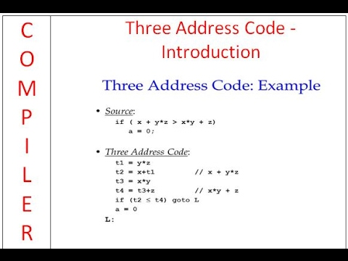
Introduction to Three-Address Code
Three-address code is an intermediate representation used in compilers.
It simplifies the compilation process by breaking down complex expressions and statements.
Understanding how to translate control statements into this form is essential for compiler design.

Slide 3
Overview of Control Statements
Control statements are crucial for program flow and decision-making.
Common control statements include if-else, switch-case, and loops such as for and while.
Each of these statements requires specific algorithms for translation into three-address code.

Slide 4
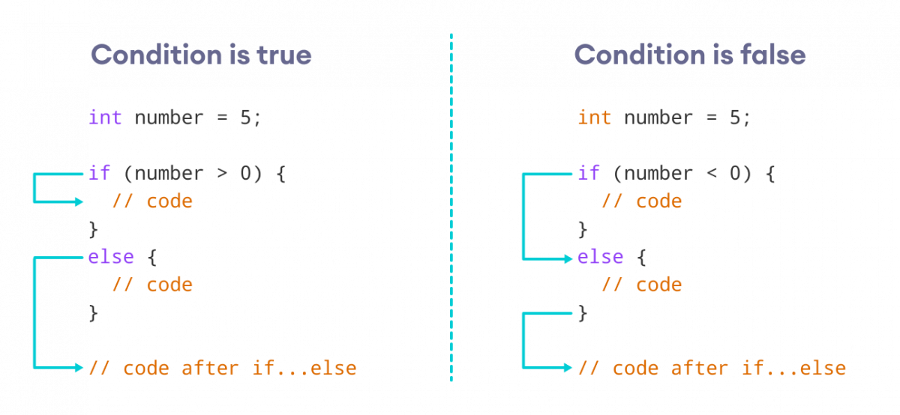
Translating If-Else Statements
The translation of if-else statements involves conditional jumps in three-address code.
The condition is evaluated, and based on its truth value, control is redirected to the corresponding block.
A typical structure includes labels for the true and false branches, followed by a jump to the end.

Slide 5
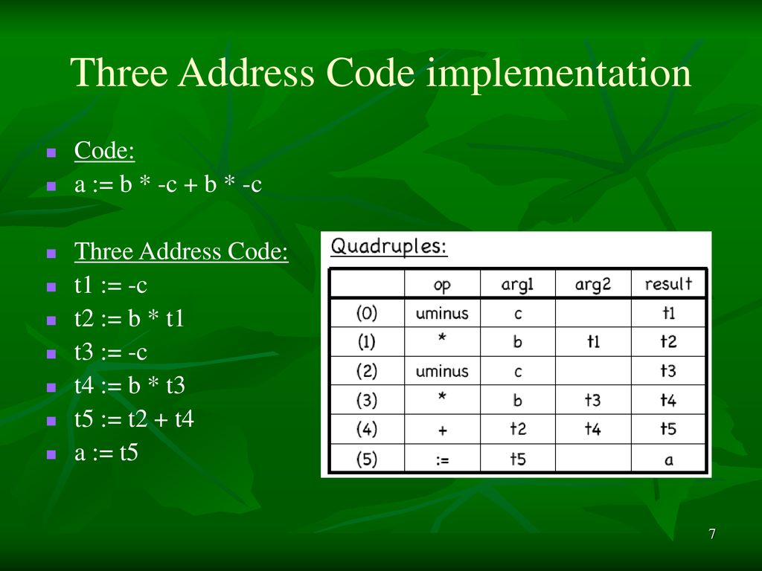
Three-Address Code for If-Else
The general format for if-else in three-address code includes a conditional check and two labels.
For example, an if statement can be represented as: `if condition goto LabelTrue; goto LabelFalse;`.
After executing the true block, a jump to the end label is used to prevent fall-through.

Slide 6
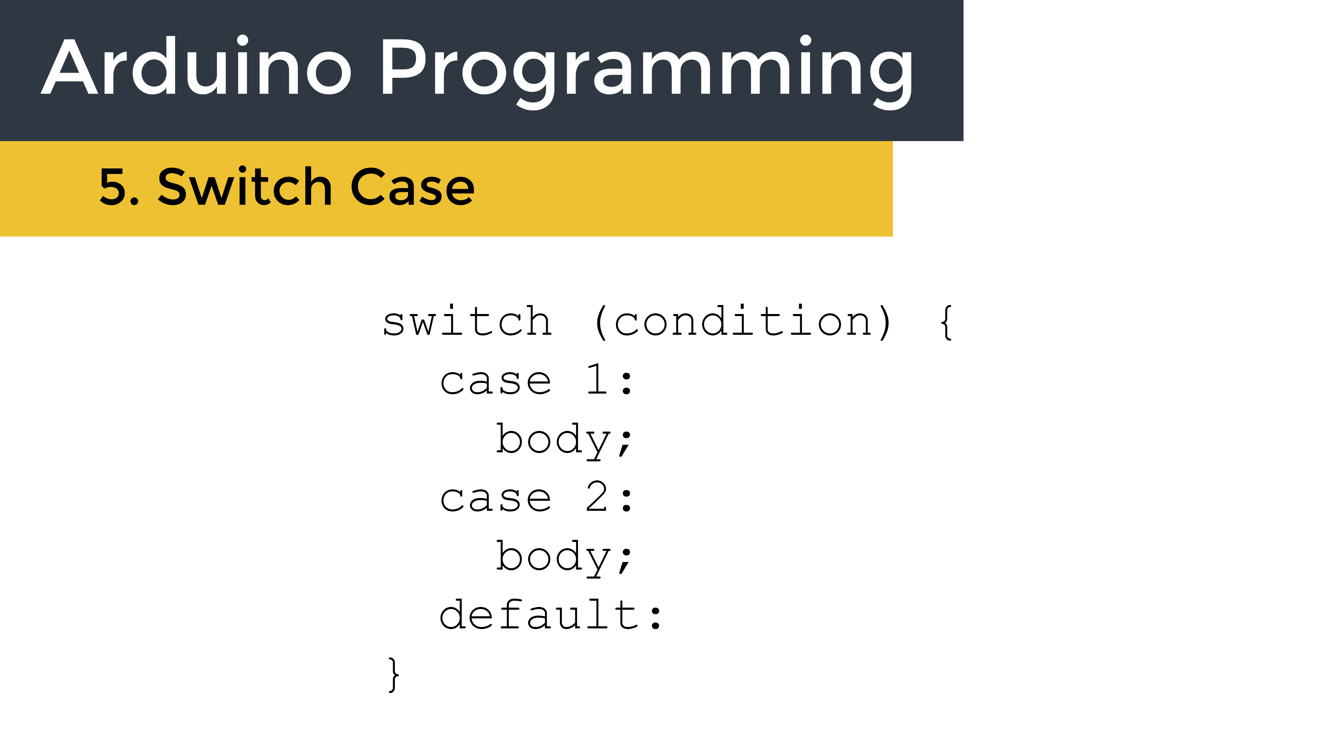
Translating Switch-Case Statements
Switch-case statements require a different approach involving jump tables or multiple conditional checks.
Each case is essentially a branch, and the switch expression is evaluated to determine the correct branch.
A default case can be added to handle any unrecognized values, similar to an else in if-else.

Slide 7
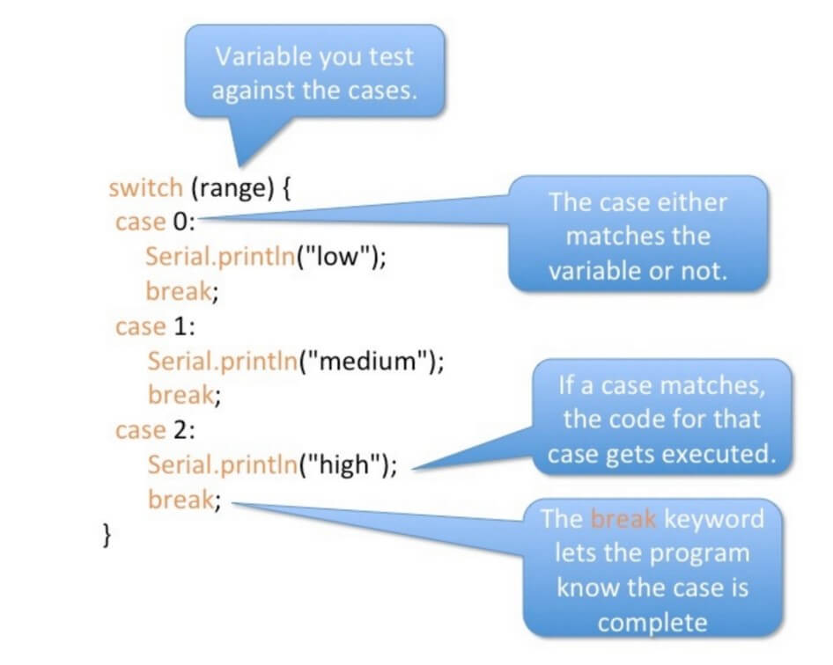
Three-Address Code for Switch-Case
The switch-case is translated into a series of comparisons and jumps in three-address code.
The general format includes evaluating the switch expression and branching according to case labels.
For example: `switch (expr) { case 1: goto Label1; ... default: goto DefaultLabel; }`.

Slide 8
Translating Loop Statements
Loops such as for and while also require careful translation to manage iteration.
The loop condition is checked before each iteration, and control branches based on its truth value.
The structure typically includes a start label, condition evaluation, and an end label.

Slide 9

Three-Address Code for Loops
For loops are translated to a sequence of instructions that checks the condition and iterates as needed.
A typical format is: `LabelStart: if condition goto LabelEnd; // loop body; goto LabelStart; LabelEnd:`.
This structure ensures that the loop can be exited appropriately when the condition fails.

Slide 10
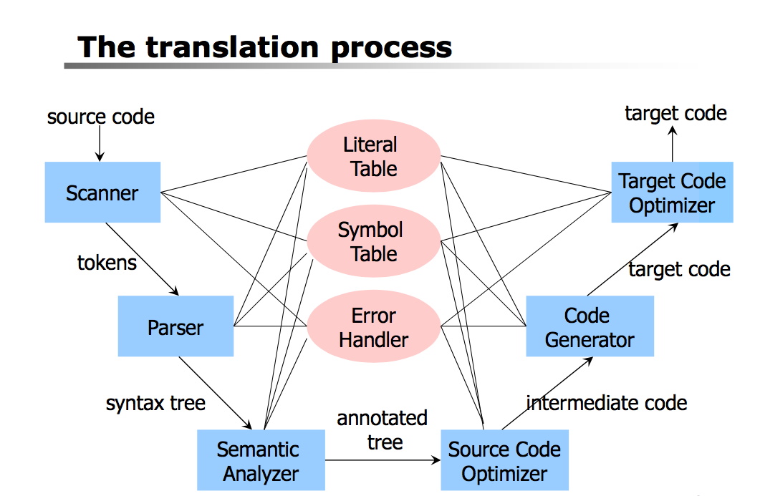
Optimization Considerations
During the translation process, certain optimizations may be applied to reduce the size of the three-address code.
Techniques such as eliminating unreachable code and combining jumps can enhance efficiency.
Ensuring minimal overhead in control statements is vital for better runtime performance.

Slide 11
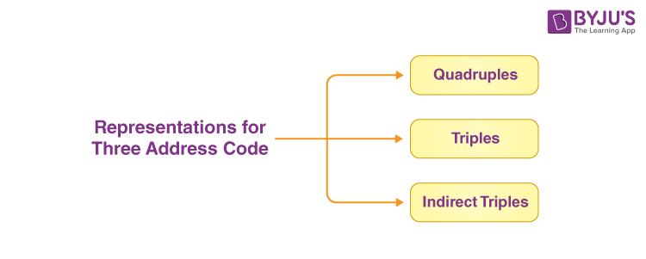
Conclusion and Importance
The ability to translate control statements into three-address code is a fundamental skill in compiler design.
This translation facilitates further optimization and code generation in the compilation process.
Mastery of these algorithms is essential for anyone aiming to work in software development or compiler construction.

Slide 12
THANK YOU

